Slide 1
JAPANESE VIDEO GAMES
IN ENGLISH TRANSLATION:
A STUDY OF CONTEMPORARY
SUBTITLING PRACTICES
Matteo Fabbretti, Ritsumeikan University

Slide 2
Welcome everybody!
I am originally from Italy but I went to University in UK (Wales!)
My field of research is Translation Studies – I mostly focus on the translation of Japanese manga and video games into English
In 2018 I was awarded a JSPS postdoctoral fellowship to do research in Japan for two years. The presentation today is based this research that was formalised into an academic article that was published last year

Slide 3
Very quick intro about Translation Studies
My approach to the study of translation is descriptive,
Basically, my aim is to describe translation phenomena and to put forward explanatory hypotheses that may help understand why things are done in a particular way or why translation practices may have changed
And hopefully also make predictions about the future!

Slide 4
Today’s topic
The focus of this presentation is a relatively recent development in the field of video game translation from Japanese into English.
Specifically, I am interested in the way some Japanese video games offer two sets of English languages subtitles,
One set of (English language) subtitles that are meant to accompany the English language voice tracks (EN-EN)
And another set of (English language) subtitles that are meant to accompany Japanese language voice tracks (JP-EN)

Slide 5
Two basic questions (well, three)
What are the main differences between the two sets of subtitles?
What factors may help explain the introduction of this new translation practice?
Bonus question:
What may happen in the future?

Slide 6
Some historical context
The practice of adding (or not removing) Japanese voice tracks in video games translated into English is a relatively recent development.
Up until the seventh generation of console games, that is to say, from around 2006 until 2012, the process of video game localisation usually meant that Japanese video games translated into English would simply replace the original Japanese voice tracks with English voice tracks.
This may have been due to disc storage issues, as multiple voice track may have been too large to fit within the capacity of a single CD or DVD (Bernal-Merino, 2015, p. 102).

Slide 7
Material constraints
With the advent of the eighth generation of video games consoles (PlayStation 4, Xbox One, etc.) in 2012, faster internet speed and increased storage capacity made it easier to overcome these material constraints, so video game firms began to ship their products with different foreign language included in the same product, or alternatively began to allow for users to download additional voice tracks of their choice directly to the consoles data storage devices (hard disk drives).

Slide 8
Persona 5
For example, Persona 5 (Atlus, 2017) published by Sega, allowed users the option of downloading the Japanese voice tracks for free as additional DLC (downloadable content) after the packaged game had already shipped, thereby removing the problem of having to compress large audio files in order to fit them into a digital optical disc storage format.

Slide 9
But why though?
Why would Japanese video game firms offer such an option?
On the one hand, a share of the English-speaking gaming community is critical of the removal of Japanese voice tracks from Japanese games. Simply put, some fans seemed to enjoy listening to the voices of Japanese voice actors, just as some moviegoers prefer subtitles to dubbing (O'Sullivan, 2011, p. 104).
Others simply dislike the way English voices sound when dubbing Japanese videogames (Schreier, 2012).

Slide 10
Undubbing
In the past, the discontent on the part of fans gave rise to a unique fan translation practice called ‘undubbing’, where English voice tracks were replaced with the original Japanese voices, sometimes also accompanied by English subtitles created by fans for those players who preferred Japanese voice acting but had no Japanese language ability (Eisenbeis, 2013).

Slide 11
Language options
Although undubbed video games are made available to download for free, Japanese firms may have understood the existence of such practices as an attempt to respond to the wishes of a part of the gaming community abroad, and, rather than ignoring these expectations or actively fighting them, they sought to meet them by including the option to choose how games could be experienced, either dubbed by English voice actors or retaining the Japanese voices accompanied by English language subtitles.

Slide 12
Transcreation
The inclusion of selectable Japanese voice tracks solved a problem, but in turn introduced new issues. To explain it simply, video game translation often requires the adoption of creative strategies, which O’Hagan and Mangiron describe as akin to ‘transcreation’ (O’Hagan and Mangiron, 2013, p. 190), that is to say, considerable adaptation is often necessary to meet the cultural and legal requirements of different countries.

Slide 13
The problem emerges when players are faced with discrepancies between subtitles and voiceovers; for example, when Japanese voice tracks use one name to refer to a character depicted on screen, while the English subtitles use a different one for the same character.

Slide 14
Xenoblade Chronicles 2
One example of this kind of discrepancy can be found in the game Xenoblade Chronicles 2 (Monolith Soft, 2017) published by Nintendo for the Nintendo Switch console.

Slide 15
Homura & Hikari
In this game, one of the main characters is an artificial being that has two distinct personalities, represented in the game by fire and light. In the Japanese version of the game, the names of these two personalities reflects their personalities and designs:
Homura (literally ‘flame’, ‘blaze’) is warm and wears red, while Hikari (literally ‘light’) is cold and wears white/green colours.

Slide 16
Pyra & Mythra
In order to preserve these design elements, the English version of Xenoblade Chronicles 2 adapted their names, translating Homura as Pyra (from ‘pyre’, thereby recalling the fire element) and Hikari as Mythra (from Mithra, the angelic divinity of light in ancient Indo-Iranian mythology).

Slide 17

Iranian Mithra
Mithra, detail from the inscription of Shapur II, Kermanshah a, Iran

Slide 18
These solutions are clever and elegant in themselves!
The problem, however, emerges when players of the English version are faced with the discrepancies that the game introduces when Japanese voices refer to these characters as Homura/Hikari while the corresponding English subtitles refer to them as Pyra/Mythra (Rogers, 2017).

Slide 19
This problem is acknowledged by players, critics and Japanese developers. For example, Ollie Barder, writing in 2018 about the imminent western release of the game Dragon Quest XI for the Nintendo Switch console (Square Enix, 2019), wondered whether the game would include Japanese voices alongside the English ones, and if so, whether the subtitles would include the original Japanese names

Slide 20
“While I respect that attention to detail a great deal, I am still hoping that if the Japanese voices are included on the Western Switch release of the game that the subtitles will be updated to match that”
(Barder, 2018)

Slide 21
In other words, the inclusion of Japanese voice tracks brings to video games the same element of vulnerability that also affects other forms of subtitling.
As the translation scholar Carol O’Sullivan noted, subtitling juxtaposes source text and target text, so that “viewers are enabled, and feel entitled, to comment on the translation solutions adopted” (O’Sullivan, 2011, p. 103)

Slide 22
How can this problem be solved? Next I will present the example of how Sega dealt with this problem, taking as a case study the game series Yakuza and its spin-off game Judgment.

Slide 23
Yakuza
Yakuza, known in Japan as Ryū ga Gotoku (⿓が如く, literally ‘Like a Dragon’) is an action adventure video game series developed and published by Sega. The series include eight main games (Yakuza 0 to 7) and a number of spin-offs.
The Yakuza games are primarily set in a fictional recreation of Tokyo, inspired in particular by the actual entertainment district of Tokyo known as Kabukichō.
The main storyline spanning from Yakuza 0 to 6 features as the main playable character Kazuma Kiryu, a reformed member of the Japanese crime syndicate (the Yakuza, also known in Japan as gokudō (極道, literally "the extreme path").

Slide 24
Despite its eventual success, the creation of the first Yakuza game was initially considered a risk. As a result of internal restructuring within Sega in the mid-2000s, the game director, Toshihiro Nagoshi, was promoted to an executive position and tasked with the creation of new games.
In interviews, Nagoshi explained that he and his team would often brainstorm new ideas while drinking casually in bars around Kabukichō, and this district at the heart of Yakuza activities became the inspiration for the new game.

Slide 25
Sega, however, initially rejected Nagoshi’s game proposal as it lacked broader appeal, as it explicitly targeted the shrinking audience of adult Japanese male players (Hester, 2021).
It was only through Nagoshi’s persistence and the backing of Sega’s chief executive at the time that the first Yakuza title was eventually released in Japan in December 2005, unexpectedly gaining a favourable response from Japanese critics and players alike.

Slide 26
In the West, the Yakuza games gained broader popularity with the release of Yakuza 0 in 2017 (Hester, 2021), but, for the purpose of this article, it is the reception of the first Yakuza game abroad (Sega, 2006) that is particularly significant.
The first Yakuza game was released internationally in September 2006 but, despite receiving full English voiceovers by a cast of famous actors, including Mark Hamill of Star Wars fame and Michael Madsen (Constantine, 2010), the game failed to gain critical and commercial success.
Following the poor reception of the first Yakuza, Sega would not create English voice overs for another Yakuza game until the release of the spin-off game Judgment (known as Judge Eyes in Japan) in June 2019 (Sega, 2019).

Slide 27
Starting with the release of Yakuza 2 in September 2008, Sega began releasing its games in North America and Europe with only Japanese voice tracks, accompanied by English subtitles. The games released in this format include Yakuza 3 (Sega, 2010), Yakuza 4 (Sega, 2011), Yakuza 5 (Sega, 2015), Yakuza 0 (Sega, 2017), and Yakuza 6 (Sega, 2018).

Slide 28
With the conclusion of the saga of Kiryu in Yakuza 6, the developers at Sega decided it was time for a new protagonist. This resulted in the creation of a spin-off game entitled Judgment, set in the same fictional world of Yakuza, featuring this time an ex-lawyer turned private investigator named Takayuki Yagami (whose face is based on the real life popular Japanese singer and actor Takuya Kimura, who also provided the voice acting for Yagami).
The story of Judgment follows Yagami as he investigates a serial murder case involving the Japanese crime syndicate and a mysterious killer. The game was released for the PlayStation 4 in Japan in December 2018 and worldwide in June 2019 (Sega, 2018, 2019).

Slide 29
For the purpose of this presentation, the most notable feature of Judgment is that it signals the start of a new translation strategy by Sega.
In short, the Western version of Judgment was released with the option to select either English voice acting or the original Japanese voices.
Additionally, the two different language options were accompanied by different subtitle tracks.

Slide 30
What do these options mean in practice? Next, I will present some examples that illustrate key differences between the two sets of subtitles, drawing a comparison between the same in-game scenes played once with English voices and English subtitles (EN/EN) and again with Japanese voices and English subtitles (JP/EN).

Slide 31
Similarities
To begin with, there are similarities: both the EN/EN and JP/EN versions make use of Japanese nouns.
For example, in the following scene, Yagami is talking to his investigative partner Masaharu Kaito.

Slide 33
The Japanese source text (Judge Eyes, Sega, 2018), reads:
Yagami: Mata genda-sensei n toko ni itte miru wa. Nanka shigoto nai katte
(Gloss translation: I am going to see Genda-sensei again. To ask if there is any work)

Slide 34
Both sets of subtitles translated this as:
Yagami: Anyway. I’m gonna swing by Genda-sensei’s place, to see if he’s got any work.

Slide 35
As can be seen from the example above, both translations retain Japanese honorifics: the noun ‘sensei’ (先⽣, literally, ‘born earlier’), used in Japanese to refer to or address teachers, doctors, politicians, lawyers and other authority figures, is used here as an honorific suffix in reference to the owner of the law firm for which Yagami worked as a lawyer.
Throughout the game, both sets of subtitles retain the use of Japanese honorific suffixes such as -san, -chan, -kun, and so on.

Slide 36
Differences
The following examples will illustrate some of the key differences between the two versions. The image below is taken from Judge Eyes (Sega, 2018). In this scene, Yagami and Kato are investigating a murder scene. Yagami is looking for clues that may lead to the ‘Mole’ (‘mogura’ in Japanese), the individual responsible for a series of gruesome murders.
In the following exchange, Kaito remarks that the police would have already investigated the crime scene:

Slide 38
Kaito: なあ 警察だってモグラは探したはずだぜ？
Kaito: Naa keisatu datte mogura wa sagashita hazudaze?
(Gloss translation: [hey/say/look], hasn’t the police already searched for the Mole?)
Kaito is a former member of the Yakuza, and in Japanese his words and speech patterns are associated with men’s gendered language, which is perceived as rough and vulgar (for example, the informal ‘da’ in place of the copula ‘desu’, and the sentence-final particle ‘ze’).

Slide 39
The EN/EN subtitles translated this as:
Kaito: Hold up a sec. The cops already did their whole song and dance searchin’ for the Mole.
As the example shows, the English voices and subtitles insert the idiomatic expression ‘the whole song and dance’ to Kaito’s question, probably with the intention of suggesting a degree of scepticism on the part of Kaito about the ability of the police. The abbreviated expression ‘searchin’ (instead of ‘searching’), also helps retaining a degree of informality in English.

Slide 40
The JP/EN subtitles translated it as:
Kaito: Look. The cops did their own investigation for the Mole.
Here Kaito’s language is more neutral and avoids the use of idiomatic expressions.

Slide 41
In another exchange between Yagami and Masamichi Shintani, of the senior lawyers at Genda’s office, Shintani calls Yagami on the phone in order to arrange a meeting to discuss the details of a case they are working on.

Slide 43
Shintani: 新⾕だ 今 中道通りまで来てる
Shintani: Shintani da. Ima, Nakamichi douri made kiteru.
(Gloss translation: Its Shintani. I am on Nakamichi street)

Slide 44
EN/EN subtitles
Shintani: Morning sunshine. I’m on Nakamichi Street.
Shintani: You know Mijore, little café, killer coffee? C’mere.
As in the previous example, the English voices and accompanying subtitles add a degree of informality and colourful expressions (‘morning sunshine’, ‘killer coffee’, ‘c’mere’) that are not present in the Japanese source text,

Slide 45
JP/EN subtitles
Shintani: It’s Shintani. I’m on Nakamichi Street.
Shintani: You know Mijore, the little café? I’ll wait for you there.
English subtitles for the Japanese voice tracks seem to keep things neutral, as far as possible.

Slide 46
The above comparisons are just two examples to illustrate the main translational differences between the two sets of subtitles in Judgment.
The analysis here is not meant to cover every aspect of the text, as this is a game that can be played for hundreds of hours, and which contains far too many examples to be exhaustively analysed here.

Slide 47
Noir Fiction
However, for the purpose of drawing a provisional hypothesis about the translation strategies adopted by the translators at Sega, these brief comparisons may help illustrate the point I wish to make here.
I want to suggest here that the aim of the EN/EN version of the game (with English voice tracks accompanied by English subtitles) seems to be the creation of a target text that allows players to draw intertextually from their knowledge of American hardboiled crime fiction.

Slide 48
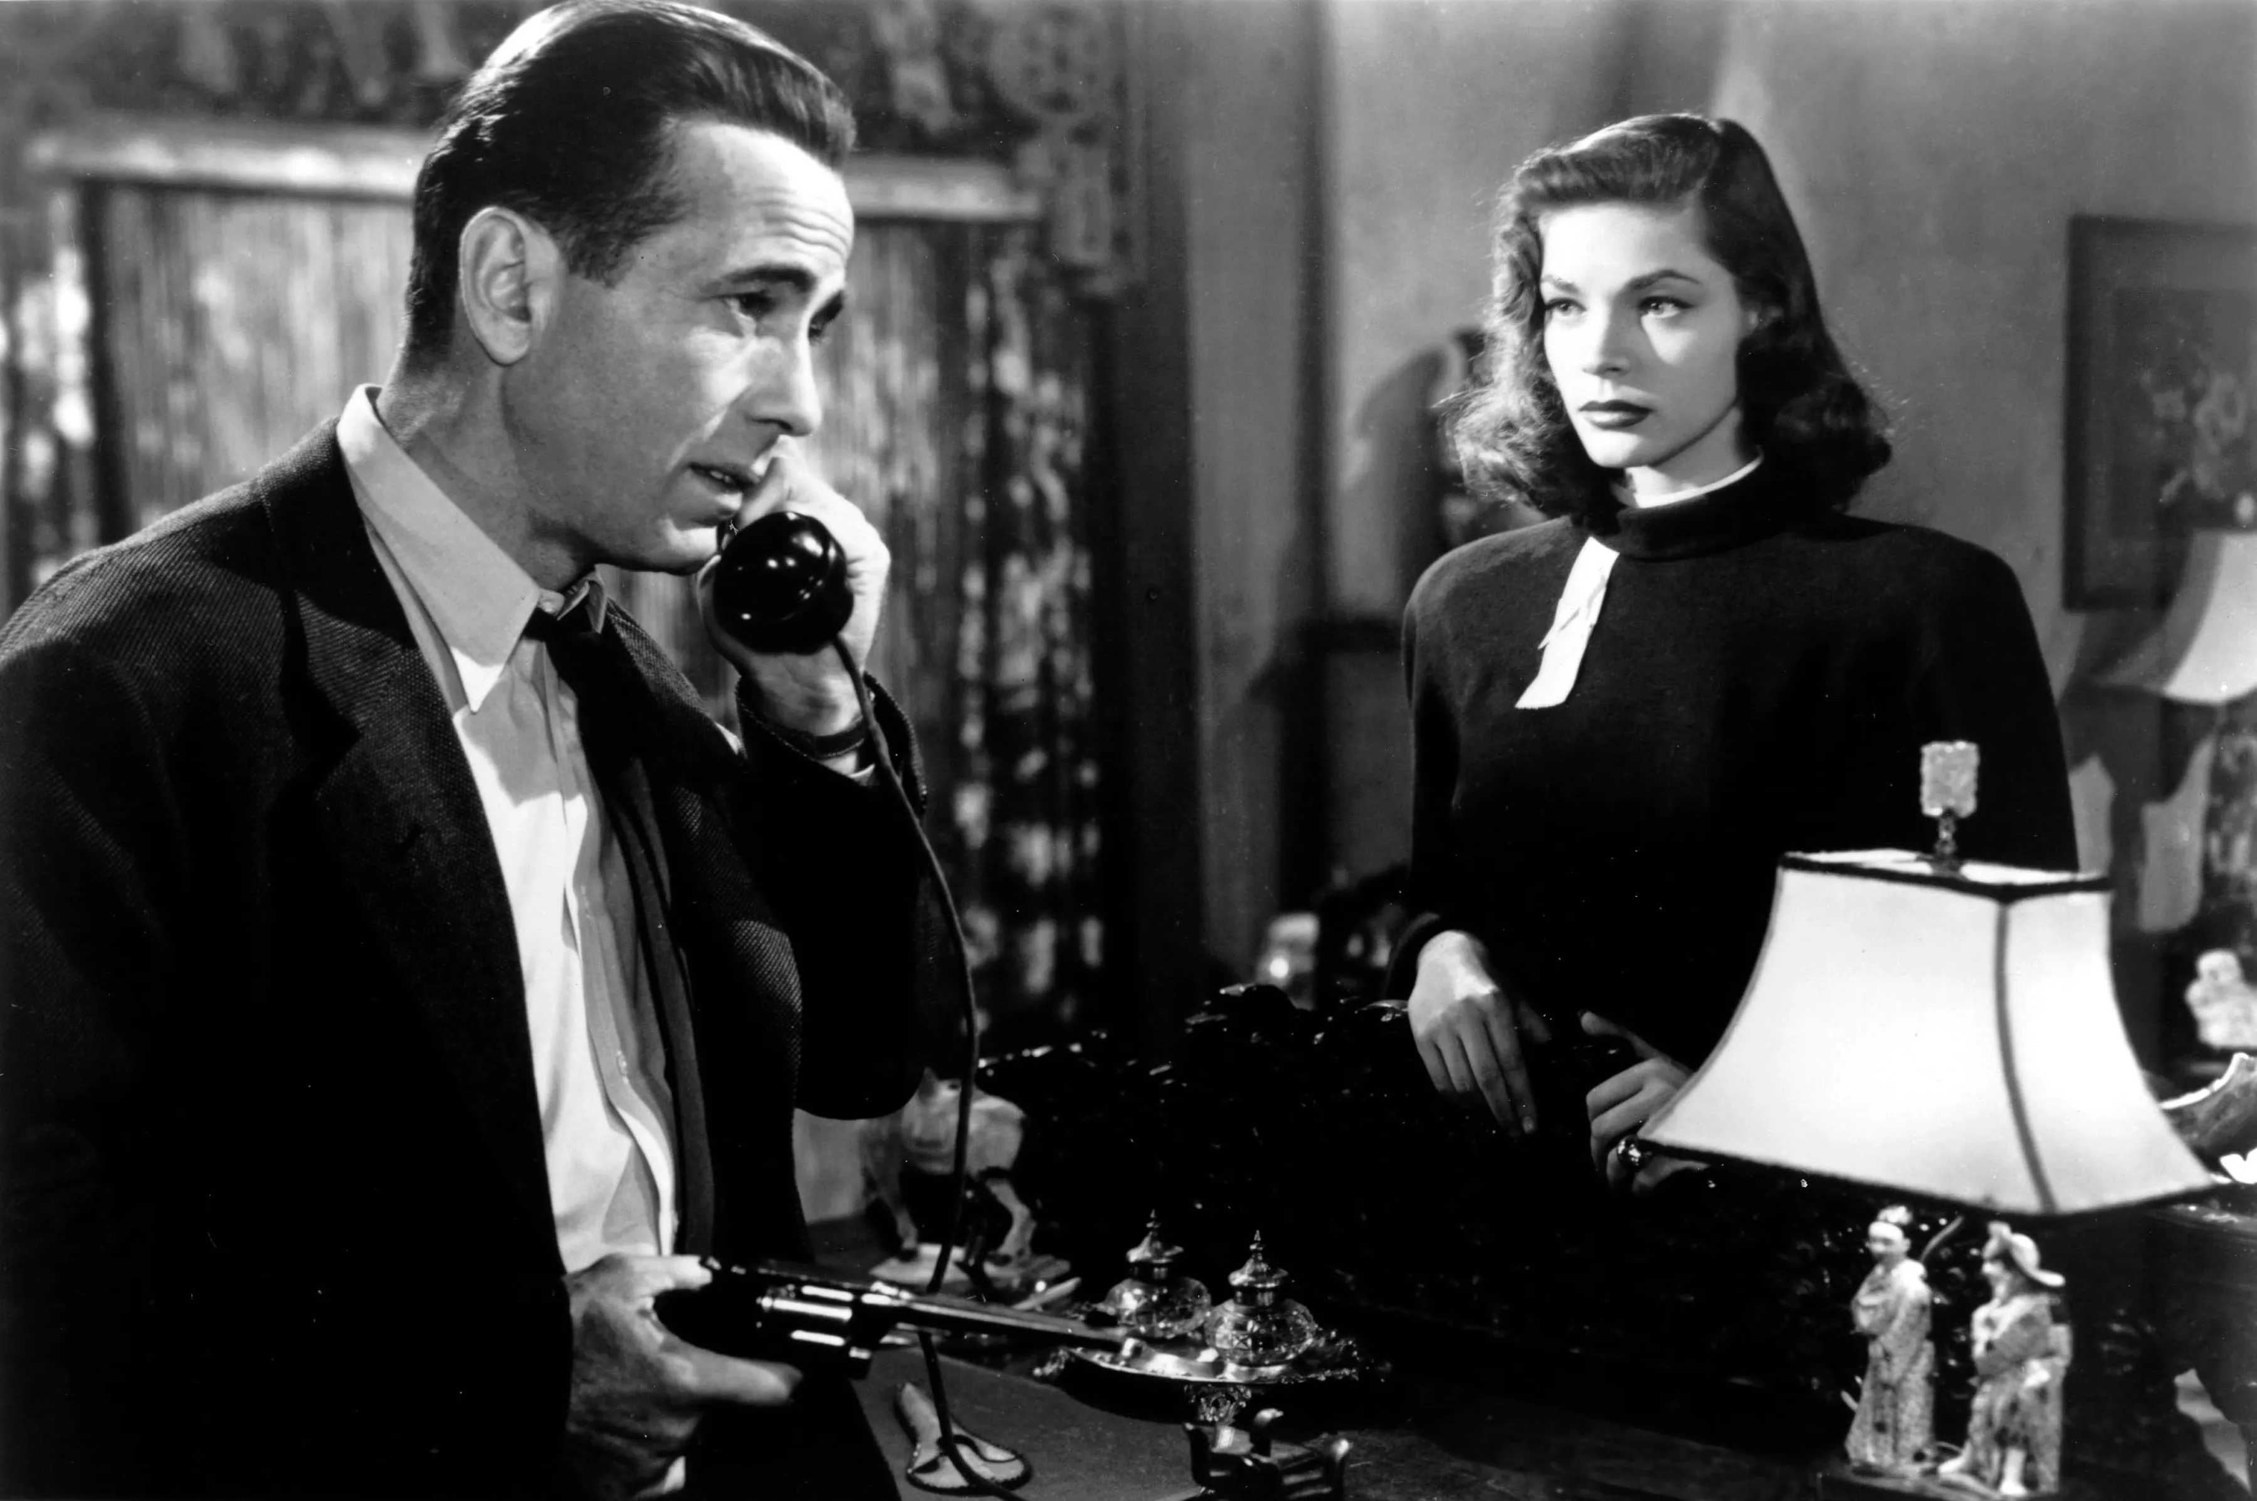

Slide 49
Here the use of informal speech, slang, and vulgar terms could be understood as a deliberate attempt to draw intertextually from the speech style of characters featured in the ‘hardboiled’ literary genre, popularised in North America with the novels of authors like Raymond Chandler and Dashiell Hammett, among others, a style that Dennis Porter defined as a “vernacular heightened and burnished to the level of street-wise poetry” (Porter, 2003, p. 105).

Slide 50
This is an understandable goal because Judgment as a text in some ways already seems to draw from this tradition of hardboiled private investigators, and for the players familiar with the conventions of this literary genre, there is an undeniable pleasure in experiencing it anew, with an interactive, contemporary medium.
In functional terms, the purpose of this version, therefore, could be seen as the creation of target text that could easily find its place alongside a well-established and prestigious domestic literary tradition.

Slide 51
What about the JP/EN subtitles?
I want to suggest that this version does not share the same purpose. In other words, this is a translation not created for an audience already familiar with the literary style of American hardboiled fiction.
Here I would like to suggest a way of conceptualising this version of the game by drawing a theoretical connection to the idea of translation into English as a Lingua Franca (ELF).

Slide 52
To put it simply, translation into ELF could be understood as translation into English for an audience of speakers that do not necessarily share the same cultural background.
The translation scholar Julianne House has argued that, unlike the English spoken by native speakers, ELF does not rely on “culturally-embedded, typically English forms such as idioms or other routinized phrases full of insider cultural-historical references invariably based on national tradition, convention or class” (House, 2013, p. 281).

Slide 53
In terms of translation aim, therefore, a translation into English as a Lingua Franca would not assume a priori that readers share the same ‘cultural-historical references’ of native English speakers, based on a shared literary tradition (such as the tradition of hardboiled crime fiction popularised in North America), and therefore would not experience the same intertextual pleasure of native English speaking players.

Slide 54
English Lingua Franca Subtitles
In other words, American culture-specific references and idioms would not have the desired effect on ELF-speaking audiences and potentially, even lessen the experience for these readers.
It is in this sense that I believe that the JP/EN subtitles in Judgment can be theorised as ‘ELF subtitles’ (in contrast to just ‘English subtitles’).

Slide 55
Conclusion and predictions
The practice of creating two sets of English subtitles to accompany different voice tracks is relatively new in the field of video games and, so far, only Sega has been releasing games in this way.
How likely is this practice to become more common in the future?

Slide 56
In my opinion, given the evidence available, Japanese videogame firms tend to be rather risk-averse and would take a dim view of the extra work, time and resources required to offer such option in games.
They would question what the return on investment would be for carrying out the extra work. Simply adding Japanese voice tracks is a relatively cost-efficient option to satisfy the fans who prefer experiencing games that way but adding an extra subtitle track would be a costlier proposition.

Slide 57
What may make a difference going forward is how this extra option may come to be understood in the near future.
It may remain an oddity, with Sega remaining the only company offering such an extravagant extra. Or, it may come to be considered a tool of digital accessibility, in the same way that subtitles for the deaf and hard-of-hearing (SDH) are.
In this second scenario, I believe that Japanese firms will be compelled to at least match the perceived valued of competing products.

Slide 58
The ultimate aim of Japanese video game firms like Sega is the creation of economic value, generating profit for their shareholders (SegaSammy Holdings Integrated Report, 2020).
For these firms, then, it would be a matter of balancing the increased costs of creating an additional language option with the potential value that such option may add to their video game products.

Slide 59
From this point of view, I believe that Japanese firms are not bound to a particular language ideology and have no intrinsic preferences in term of translation orientation.
Rather, their aim is to generate value for their customer and shareholders. In other words, if players will come to expect ELF subtitles as part of a video game product, firms will surely find a way to provide this option, like Sega is already doing.

Slide 60
Furthermore, if additional ELF subtitles become the new norm, it may be the case that not offering this option may become the riskier proposition.
I believe that, particularly in the case of games that are explicitly set in a fictional recreation of Japan like Yakuza and Judgment, fans and critics could make their expectations heard loudly, so there would be pressure on developers to meet these expectations.
Of course, companies that do not create such games may not experience the same pressure.

Slide 61
I believe that as long as ELF subtitles do not replace ‘native English’ subtitles, offering the choice of selecting different translation orientations will become more popular in the future.
The factors constraining this option may perhaps be material, financial, or simply dictated by constraints in planning and logistics; but firms will strive to meet the expectations of players as much as they can, simply as a way to increase customer satisfaction and eventually improve the sale of their products.

Slide 62
Bibliography
Fabbretti, M. A study of contemporary subtitling practices. Translation Matters, 4(1), 2022, pp. 66-85, DOI: https://doi.org/10.21747/21844585/tm4_1a5

